Slide 1
Reading List & Outlook Event Bridge
Team Leeroy Jenkins
Stephen Arsenault, pascal st-denis, francis grignon, li wang

Slide 2
Team Leeroy Jenkins
Stephen Arsenault – Computer Science Co-op University of Windsor
Francis Grignon – Technical Advisor, Statistics Canada
Pascal St-Denis – Technical Advisor, Statistics Canada
Li Wang – System Analyst / Technical Advisor, Statistics Canada

Slide 3
Reading List Plugin
Lots of blogs, not enough time
Bookmarks
geared towards more permanent items
Not easy to add
Reading list
subset of bookmarks for momentary items (ie. Blog post)
One-click add and delete

Slide 4
Reading List Plugin
Implemented as a standalone plugin using hooks and registers
Depends on Bookmarks, Wet, and Blogs plugins
Further work: incorporate Files, discussions, job posts

Slide 5
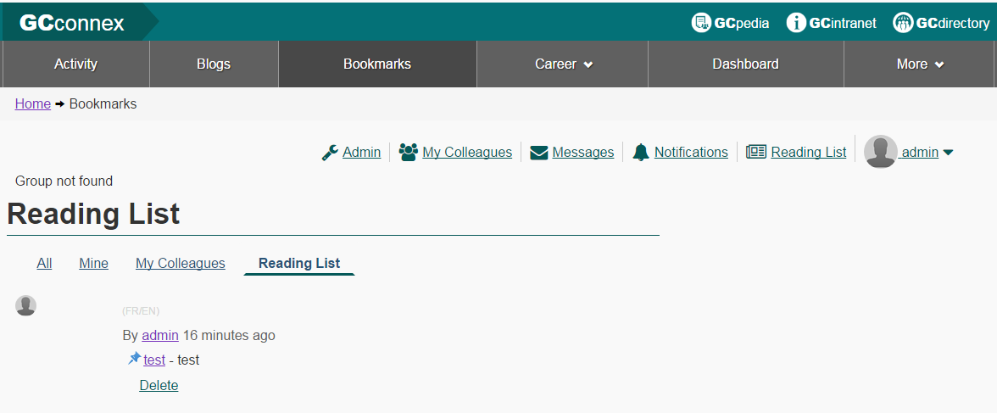
Reading List Plugin

Slide 6
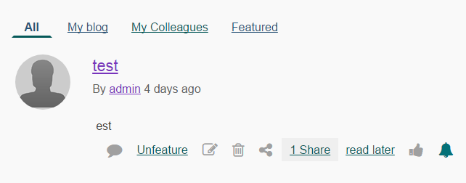
Reading List Plugin

Slide 7
Outlook Event Bridge
Import and Export GCConnex events to / from Outlook
GCConnex events are isolated within GCConnex
Easy to forget or get doubled booked when they’re not in your work calendar
Integrated existing plugin (event calendar ical)
Added bilingualism, html format support

Slide 8
Demo

